Slide 1
System Modeling
Chapter 5-Software Engineering by Ian Sommerville

Slide 2
Content
Context models
Structural models
Behavioral models

Slide 3
System Modeling
System modeling is the process of developing abstract models of a system, with each model presenting a different view or perspective of that system.
System modeling has generally come to mean representing the system using some kind of graphical notation, which is now almost always based on notations in the Unified Modeling Language (UML)

Slide 4
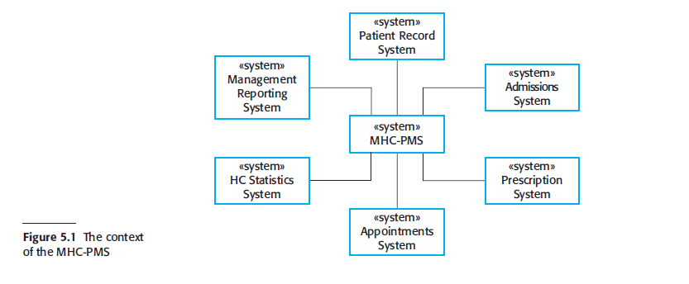
System Model

Slide 5
Static vs Dynamic Modeling
A structural perspective, where you model the organization of a system or the structure of the data that is processed by the system.
A behavioral perspective, where you model the dynamic behavior of the system and how it responds to events.

Slide 6
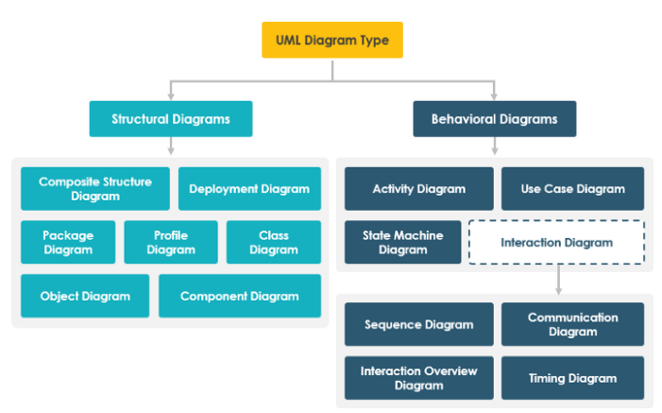

Slide 7
Static vs Dynamic Modeling
UML diagrams represent these two aspects of a system:
Structural (or Static) view: emphasizes the static structure of the system using objects, attributes, operations and relationships. It includes class diagrams and composite structure diagrams.
Behavioral (or Dynamic) view: emphasizes the dynamic behavior of the system by showing collaborations among objects and changes to the internal states of objects. This view includes sequence diagrams, activity diagrams, and state machine diagrams.

Slide 8
The Unified Modeling Language
The Unified Modeling Language is a set of 13 different diagram types that may be used to model software systems.
It emerged from work in the 1990s on object-oriented modeling where similar object-oriented notations were integrated to create the UML.
A major revision (UML 2) was finalized in 2004.
The UML is universally accepted as the standard approach for developing models of software systems.
Variants have been proposed for more general system modeling.

Slide 9
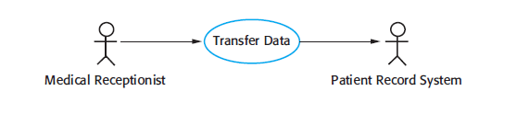
Use-case Diagram
A use case diagram is a graphical depiction of a user's possible interactions with a system.
A use case diagram shows various use cases and different types of users the system has and will often be accompanied by other types of diagrams as well

Slide 10
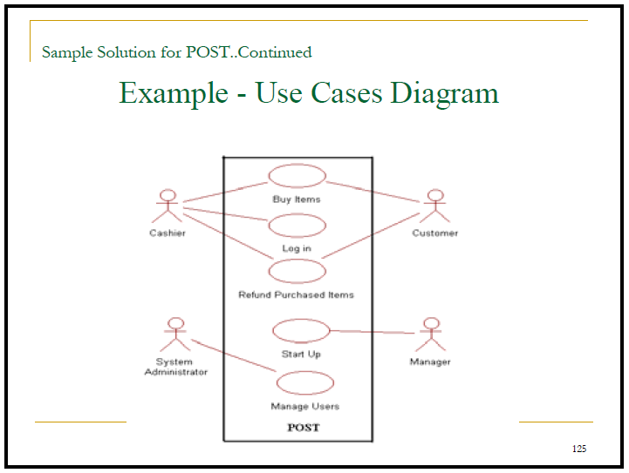

Slide 11
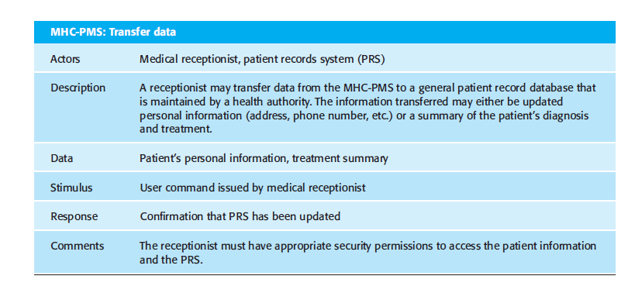

Slide 12
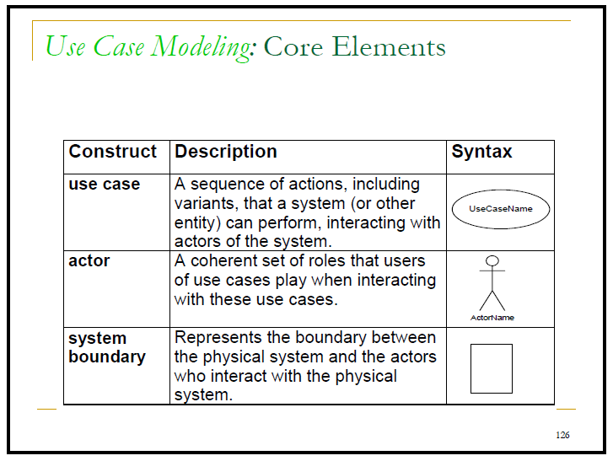

Slide 13
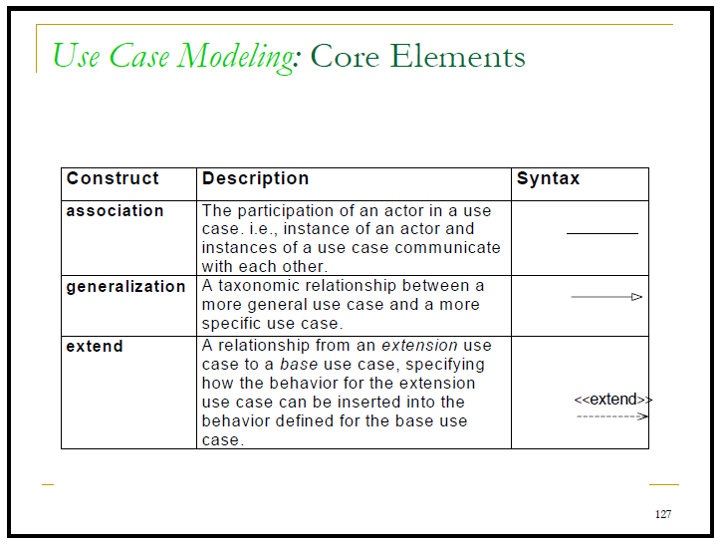

Slide 14
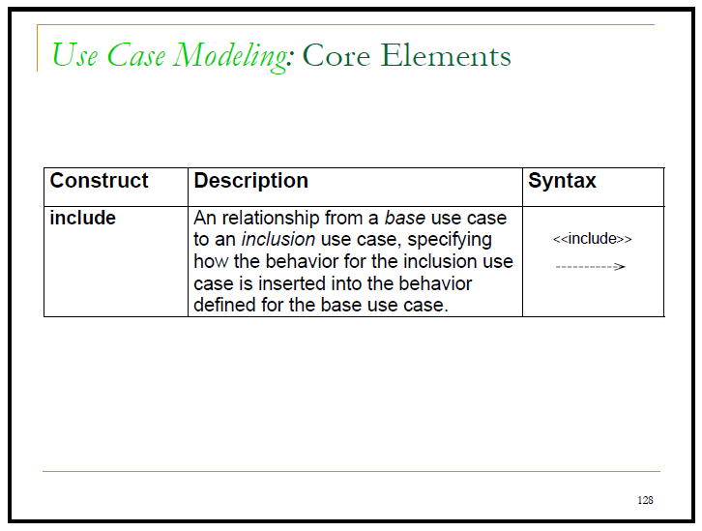

Slide 15
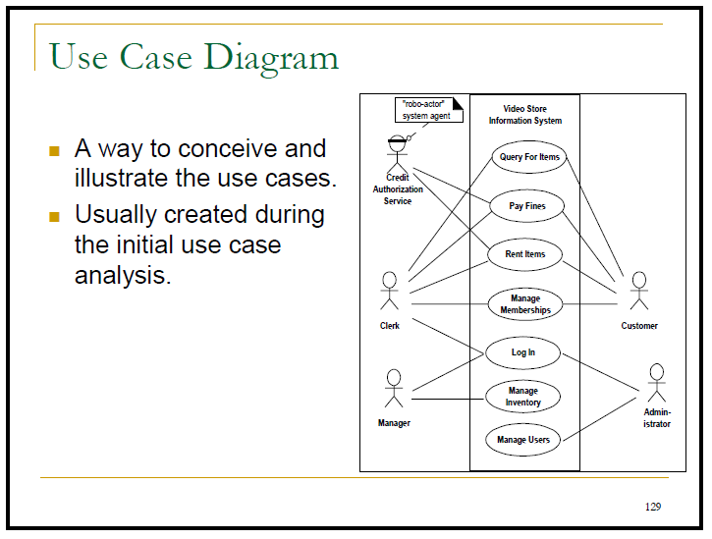

Slide 16
Use-case & Dynamicity
To model a system, the most important aspect is to capture the dynamic behavior. Dynamic behavior means the behavior of the system when it is running/operating.
Only static behavior is not sufficient to model a system rather dynamic behavior is more important than static behavior. In UML, there are five diagrams available to model the dynamic nature and use case diagram is one of them. Now as we have to discuss that the use case diagram is dynamic in nature, there should be some internal or external factors for making the interaction.

Slide 17
Purpose of Use Case Diagrams
The purpose of use case diagram is to capture the dynamic aspect of a system

Slide 18
Purpose of Usecase Diagram
Use case diagrams are used to gather the requirements of a system including internal and external influences. These requirements are mostly design requirements. Hence, when a system is analyzed to gather its functionalities, use cases are prepared and actors are identified.

Slide 19
Purpose of Use-case Diagram
In brief, the purposes of use case diagrams can be said to be as follows −
Used to gather the requirements of a system.
Used to get an outside view of a system.
Identify the external and internal factors influencing the system.
Show the interaction among the requirements are actors.

Slide 20
How to Draw a Use Case Diagram?
When we are planning to draw a use case diagram, we should have the following items identified.
Functionalities to be represented as use case
Actors
Relationships among the use cases and actors.

Slide 21
Cont..
Use case diagrams are considered for high level requirement analysis of a system. When the requirements of a system are analyzed, the functionalities are captured in use cases.
We can say that use cases are nothing but the system functionalities written in an organized manner. The second thing which is relevant to use cases are the actors. Actors can be defined as something that interacts with the system.
Actors can be a human user, some internal applications, or may be some external applications.

Slide 22
Cont..
The name of a use case is very important. The name should be chosen in such a way so that it can identify the functionalities performed.
Give a suitable name for actors.
Show relationships and dependencies clearly in the diagram.
Do not try to include all types of relationships, as the main purpose of the diagram is to identify the requirements.
Use notes whenever required to clarify some important points.

Slide 23
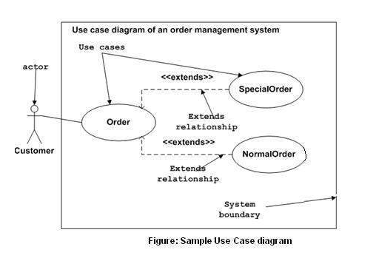
Example :Order Management System
Notes:
Reference material from Creatly.

Slide 24
Example:Explanation
The SpecialOrder and NormalOrder use cases are extended from Order use case. Hence, they have extended relationship. Another important point is to identify the system boundary, which is shown in the picture. The actor Customer lies outside the system as it is an external user of the system.

Slide 25
Usecase Relationships
There can be 5 relationship types in a use case diagram.
Association between actor and use case
Generalization of an actor
Extend between two use cases
Include between two use cases
Generalization of a use case

Slide 26
Association Between Actor and Use Case
This one is straightforward and present in every use case diagram. Few things to note.
An actor must be associated with at least one use case.
An actor can be associated with multiple use cases.
Multiple actors can be associated with a single use case

Slide 27
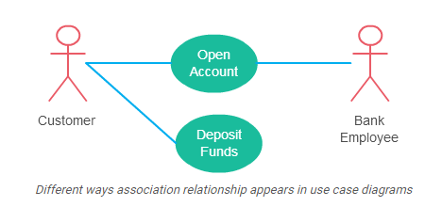
Example

Slide 28
Generalization of an Actor
Generalization of an actor means that one actor can inherit the role of the other actor. The descendant inherits all the use cases of the ancestor. The descendant has one or more use cases that are specific to that role. Let’s expand the previous use case diagram to show the generalization of an actor

Slide 29
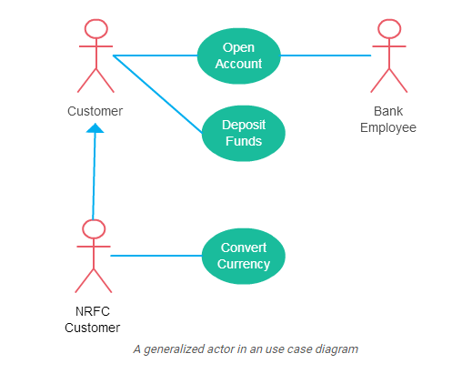
Example

Slide 30
Extend Relationship Between Two Use Cases
Many people confuse the extend relationship in use cases. As the name implies it extends the base use case and adds more functionality to the system. Here are a few things to consider when using the <<extend>> relationship.
The extending use case is dependent on the extended (base) use case. In the below diagram the “Calculate Bonus” use case doesn’t make much sense without the “Deposit Funds” use case.
The extending use case is usually optional and can be triggered conditionally. In the diagram, you can see that the extending use case is triggered only for deposits over 10,000 or when the age is over 55.
The extended (base) use case must be meaningful on its own. This means it should be independent and must not rely on the behavior of the extending use case.

Slide 31
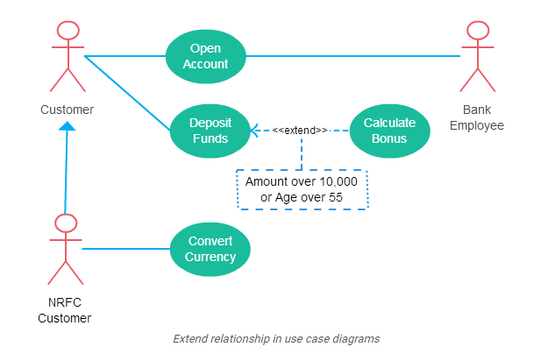
Example

Slide 32
Example
Although extending use case is optional most of the time it is not a must. An extending use case can have non-optional behavior as well. This mostly happens when your modeling complex behaviors.
For example, in an accounting system, one use case might be “Add Account Ledger Entry”. This might have extending use cases “Add Tax Ledger Entry” and “Add Payment Ledger Entry”. These are not optional but depend on the account ledger entry. Also, they have their own specific behavior to be modeled as a separate use case.

Slide 33
Include Relationship Between Two Use Cases
Include relationship show that the behavior of the included use case is part of the including (base) use case. The main reason for this is to reuse common actions across multiple use cases. In some situations, this is done to simplify complex behaviors. Few things to consider when using the <<include>> relationship.
The base use case is incomplete without the included use case.
The included use case is mandatory and not optional.

Slide 34
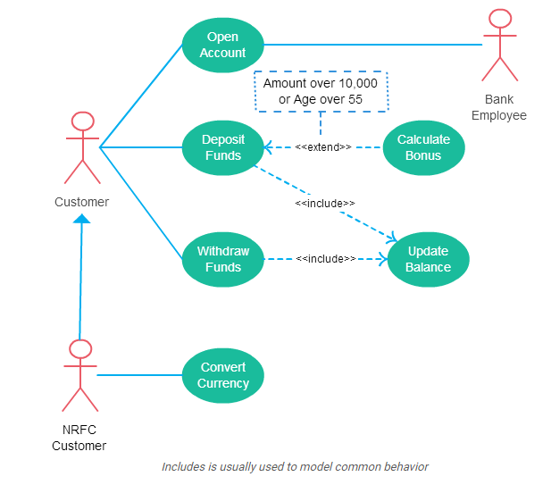
Example

Slide 35
Generalization of a Use Case
This is similar to the generalization of an actor. The behavior of the ancestor is inherited by the descendant. This is used when there is common behavior between two use cases and also specialized behavior specific to each use case.

Slide 36
Example
For example, in the previous banking example, there might be a use case called “Pay Bills”. This can be generalized to “Pay by Credit Card”, “Pay by Bank Balance” etc.

Slide 37
Descriptive Usecase
A use case description is a text-based narrative of a functionality comprised of detailed, step-by-step interaction between the actor and the system.
It describes the outcomes of an action taken to accomplish a specific goal.
It also details different paths that can be followed by defining primary, alternate, and exception flows.
Use cases are written from the point of view of the actor and avoid describing the internal aspects of the solution.

Slide 38
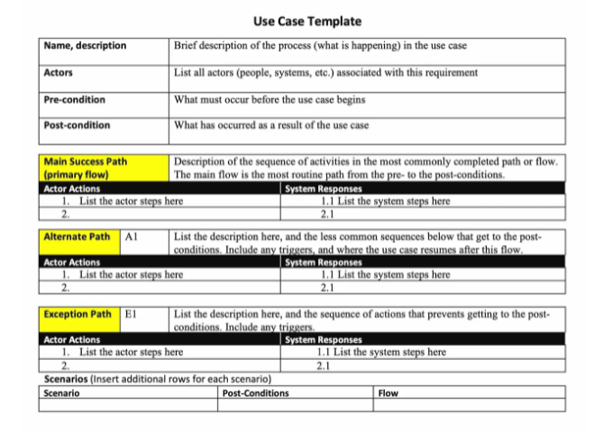
Descriptive Use-case Template

Slide 39
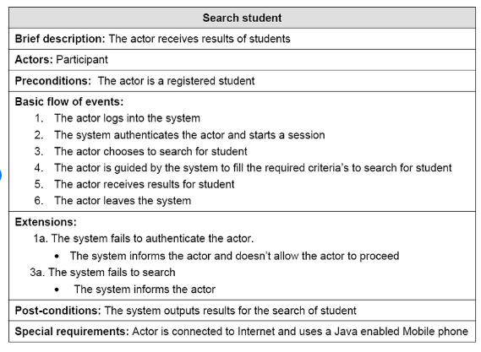
Example-Search Student

